Slide 1
Job Posting Analysis
Adam Sampson
Jack Letcher
Taylor Maxson
Nathan Thomas

Slide 2

https://www.bing.com/images/search?view=detailV2&ccid=Y9XgRZ8V&id=1E283B45F3583F02D5E895D7A5073722633532B6&thid=OIP.Y9XgRZ8VMJhjgsew2AF2ogEsDH&mediaurl=http%3a%2f%2fimages.techhive.com%2fimages%2farticle%2f2016%2f03%2fcorrelation-one-100653446-primary.idge.jpg&exph=413&expw=620&q=data+scientist+jobs&simid=608030408846868974&selectedIndex=2&ajaxhist=0

Slide 3
Overview
Business Purpose
Data Exploration
Identifying the different types of information in the text
Data Preparation
Separate preparation for each type of model
Modeling
Topic modeling
k-Means Clustering
Tf-idf ranking
Jaccard similarity ranking
Evaluation

Slide 4
Business Purpose
Problem: Job Applicants, HR departments, and Headhunter Firms have to hunt through a large number of job postings and resumes trying to match candidates to jobs.
Basic job searches online may only include a handful of words.
HR or Headhunters may be able to search resume’s by keywords to check for mandatory values, but this only gives knowledge of whether a candidate has some or all of the required/desired items in their resume

Slide 5
Business Purpose Cont’d
Headhunter firms have a goal of finding candidates that will be qualified for jobs while wasting as little time as possible.
Rank potential candidates by how close they match jobs
Start with best candidates
Eliminate definite misses
Be prepared to cold-call candidates even for jobs a candidate may not be considering
Identify weaknesses in a candidate’s resume to increase odds of successful placement at a company (and commission)

Slide 6
Business Purpose Cont’d
Score resume match to job posting
1
List missing items in resume for job postings
2
Identify similar jobs to increase odds of matching candidate to some job
3

Slide 7

Define a question and an approach
Image by Kenneth Jensen [CC BY-SA 3.0 (https://creativecommons.org/licenses/by-sa/3.0)], via Wikimedia Commons

Slide 8
Data Exploration
Job Posting
Resume
Webscraped in <XML> format
Sectioned by company
Job ID
Job Title
Job Description
Many documents available
Non-uniform
Mix of narrative, lists, matrixes, etc.
Limited documents available

Slide 9
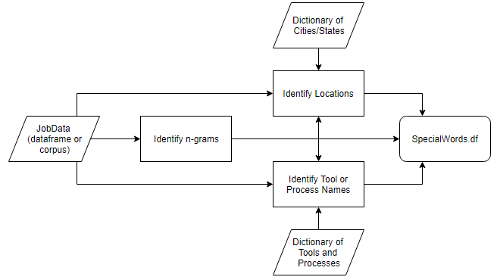
Data Exploration

Slide 10
Data Preparation

Slide 14
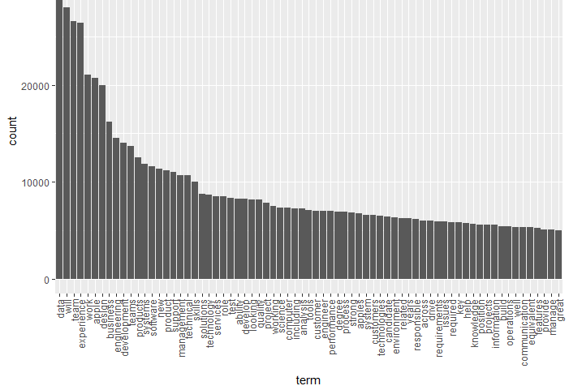
Most Frequent Terms
Top Terms:
Data
Will
Team
Experience
Work
Apple
Design
Business
Engineering
Development

Slide 15
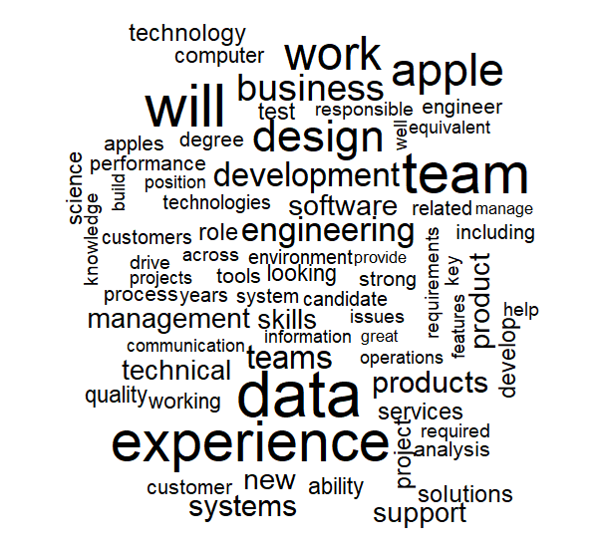
Visual of the top terms

Slide 16
Evaluation

Slide 18
Next Steps…

